Slide 1
Next.js

Slide 2
json data server
npm install -g json-server
# 또는
yarn global add json-server

Slide 3
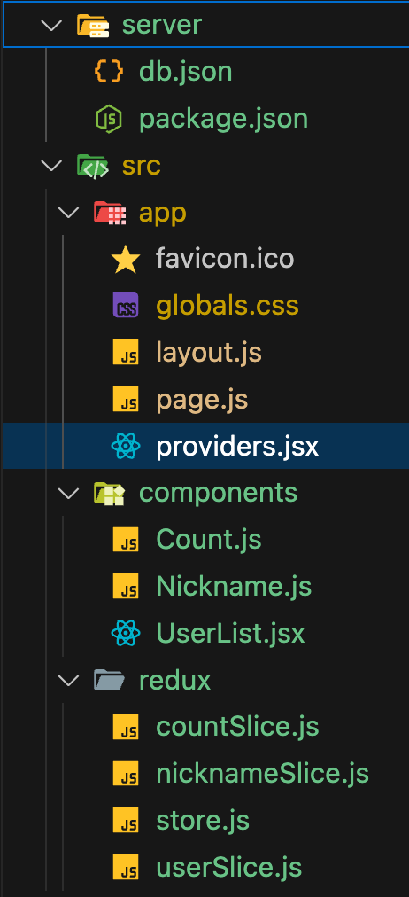
폴더 구조

Slide 4
db.json

Slide 5
{
"users": [
{ "id": 1, "name": "Alice", "age": 30, "email": "alice@example.com", "city": "New York" },
{ "id": 2, "name": "Bob", "age": 25, "email": "bob@example.com", "city": "Los Angeles" },
{ "id": 3, "name": "Charlie", "age": 35, "email": "charlie@example.com", "city": "Chicago" },
{ "id": 4, "name": "David", "age": 28, "email": "david@example.com", "city": "Houston" },
{ "id": 5, "name": "Eve", "age": 22, "email": "eve@example.com", "city": "Phoenix" },
{ "id": 6, "name": "Jona", "age": 40, "email": "jona@example.com", "city": "Philadelphia" },
{ "id": 7, "name": "Kim", "age": 31, "email": "kim@example.com", "city": "San Antonio" }
], }

Slide 6
"products": [
{ "id": "A1", "name": "Laptop", "price": 1200, "category": "Electronics", "inStock": true },
{ "id": "B2", "name": "Mouse", "price": 25, "category": "Electronics", "inStock": true },
{ "id": "C3", "name": "Keyboard", "price": 75, "category": "Electronics", "inStock": false },
{ "id": "D4", "name": "Monitor", "price": 300, "category": "Electronics", "inStock": true },
{ "id": "E5", "name": "Tablet", "price": 450, "category": "Electronics", "inStock": true },
{ "id": "F6", "name": "Smartphone", "price": 900, "category": "Electronics", "inStock": true },
{ "id": "G7", "name": "Headphones", "price": 150, "category": "Electronics", "inStock": false },
{ "id": "H8", "name": "T-Shirt", "price": 20, "category": "Apparel", "inStock": true },
{ "id": "I9", "name": "Jeans", "price": 60, "category": "Apparel", "inStock": true },
{ "id": "J10", "name": "Book", "price": 15, "category": "Books", "inStock": true }
]
}

Slide 7
package.json

Slide 8
{
"name": "my-json-server-project",
"version": "1.0.0",
"description": "",
"main": "index.js",
"scripts": {
"start": "json-server --watch db.json --port 3001"
},
"keywords": [],
"author": "",
"license": "ISC",
"dependencies": {
"json-server": "^0.17.4" // 예시 버전l
}
}

Slide 9
실행 명령어
json-server --watch db.json --port 3001

Slide 10
Next.js 프로젝트 생성
npx create-next-app@latest my-next-app
or
yarn create next-app my-next-app
✔ Would you like to use TypeScript? › No / Yes
✔ Would you like to use ESLint? › Yes
✔ Would you like to use Tailwind CSS? › Yes
✔ Would you like to use `src/` directory? › Yes
✔ Would you like to use App Router (recommended)? › Yes
✔ Would you like to customize the default import alias? › No

Slide 11
라이브러리
npm install @reduxjs/toolkit react-redux
or
yarn add @reduxjs/toolkit react-redux

Slide 12
app/layout.js

Slide 13
// app/layout.js 또는 layout.tsx
import { Providers } from './providers'; // store를 감싸는 컴포넌트
export default function RootLayout({ children }) {
return (
<html lang="en">
<body>
<Providers>{children}</Providers> {/* ✅ 이 부분 중요 */}
</body>
</html>
);
}

Slide 14
app/page.js

Slide 15
'use client';
import Count from '../components/Count';
import Nickname from '../components/Nickname';
import UserList from '../components/UserList';
export default function Home() {
return (
<main style={{ padding: '2rem' }}>
<h1>Redux 예제</h1>
<Count />
<hr />
<Nickname />
<hr />
<UserList />
</main>
);
}

Slide 16
app/Providers.jsx

Slide 17
'use client';
import { Provider } from 'react-redux';
import { store } from '../redux/store';
export function Providers({ children }) {
return <Provider store={store}>{children}</Provider>;
}

Slide 18
components/Count.jsx

Slide 19
'use client';
import React from 'react';
import { useDispatch, useSelector } from 'react-redux';
import { increase, decrease } from '../redux/countSlice';
const Count = () => {
const count = useSelector((state) => state.count.value);
const dispatch = useDispatch();
return (
<>
<p>
Count: <b>{count}</b>
</p>
<button onClick={() => dispatch(increase())}>+</button>
<button onClick={() => dispatch(decrease())}>-</button>
</>
);
};
export default Count;

Slide 20
components/Nickname.jsx

Slide 21
'use client';
import React, { useCallback } from 'react';
import { useDispatch, useSelector } from 'react-redux';
import { changeInput } from '../redux/nicknameSlice';
const Nickname = () => {
const { name, nickname } = useSelector((state) => state.nickname);
const dispatch = useDispatch();
const handleOnChange = useCallback((e) => {
const { name, value } = e.target;
dispatch(changeInput({ name, value }));
}, [dispatch]);

Slide 22
return (
<>
<div>
<input type="text" name="name" value={name} onChange={handleOnChange} placeholder="이름" />
</div>
<div>
<input type="text" name="nickname" value={nickname} onChange={handleOnChange} placeholder="닉네임" />
</div>
<div>
<b>이름: </b> {name}
</div>
<div>
<b>닉네임: </b> {nickname}
</div>
</>);};
export default Nickname;

Slide 23
components/UserList.jsx

Slide 24
'use client';
import React, { useEffect } from 'react';
import { useDispatch, useSelector } from 'react-redux';
import { fetchUsers } from '../redux/userSlice';
const UserList = () => {
const dispatch = useDispatch();
const { loading, data: users, error } = useSelector((state) => state.user);
useEffect(() => {
dispatch(fetchUsers());
}, [dispatch]);

Slide 25
return (
<div>
<h1>사용자 목록</h1>
{loading && <p>사용자 데이터를 불러오는 중...</p>}
{error && <p>에러 발생: {error}</p>}
{!loading && users.length === 0 && <p>사용자 데이터가 없습니다.</p>}
<ul>
{users.map((user) => (
<li key={user.id}>
<strong>{user.name}</strong> ({user.age}세, {user.city}) - {user.email}
</li>
))}
</ul>
</div>);};
export default UserList;

Slide 26
redux/countSlice.js

Slide 27
import { createSlice } from '@reduxjs/toolkit';
export const countSlice = createSlice({
name: 'count',
initialState: { value: 0, },
reducers: {
increase: (state) => {
state.value += 1;
},
decrease: (state) => {
state.value -= 1;
},},});
export const { increase, decrease } = countSlice.actions;
export default countSlice.reducer;

Slide 28
redux/nicknameSlice.js

Slide 29
import { createSlice } from '@reduxjs/toolkit';
const nicknameSlice = createSlice({
name: 'nickname',
initialState:{
name: '',
nickname: '',
},
reducers: {
changeInput: (state, action) => {
const { name, value } = action.payload;
state[name] = value;
},},});
export const { changeInput } = nicknameSlice.actions;
export default nicknameSlice.reducer;

Slide 30
redux/userSlice.js

Slide 31
import { createSlice, createAsyncThunk } from '@reduxjs/toolkit';
import axios from 'axios';
export const fetchUsers = createAsyncThunk('users/fetchUsers', async (_, thunkAPI) => {
try {
const response = await axios.get('http://localhost:3001/users'); // json-server 사용 시
return response.data;
} catch (error) {
return thunkAPI.rejectWithValue(error.message);
}
});

Slide 32
const userSlice = createSlice({
name: 'users',
initialState: { loading: false, data: [], error: null,},
extraReducers: (builder) => {
builder
.addCase(fetchUsers.pending, (state) => {
state.loading = true;
state.error = null;
})
.addCase(fetchUsers.fulfilled, (state, action) => {
state.loading = false;
state.data = action.payload;
})
.addCase(fetchUsers.rejected, (state, action) => {
state.loading = false;
state.error = action.payload || '에러 발생';
}); },});
export default userSlice.reducer;

Slide 33
redux/store.js

Slide 34
import { configureStore } from '@reduxjs/toolkit';
import countReducer from './countSlice';
import nicknameReducer from './nicknameSlice';
import userReducer from './userSlice';
export const store = configureStore({
reducer: {
count: countReducer,
nickname: nicknameReducer,
user: userReducer,
},
});

